Slide 1
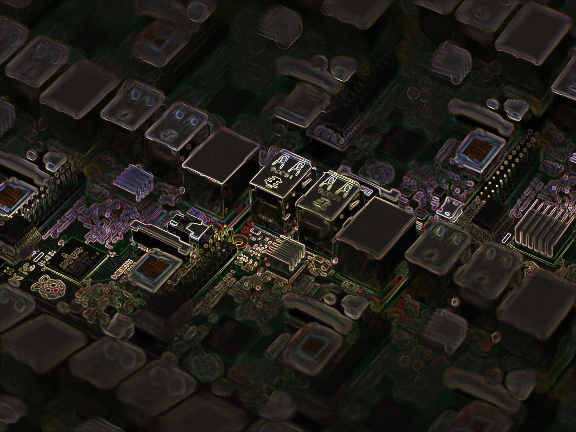
SMART PARKING USING RASPBERRY PI
- GROUP MEMBERS:
Nandini Sharma (501654)
Aadya Singh (501658)
Sneha Singh (501659)

Slide 2
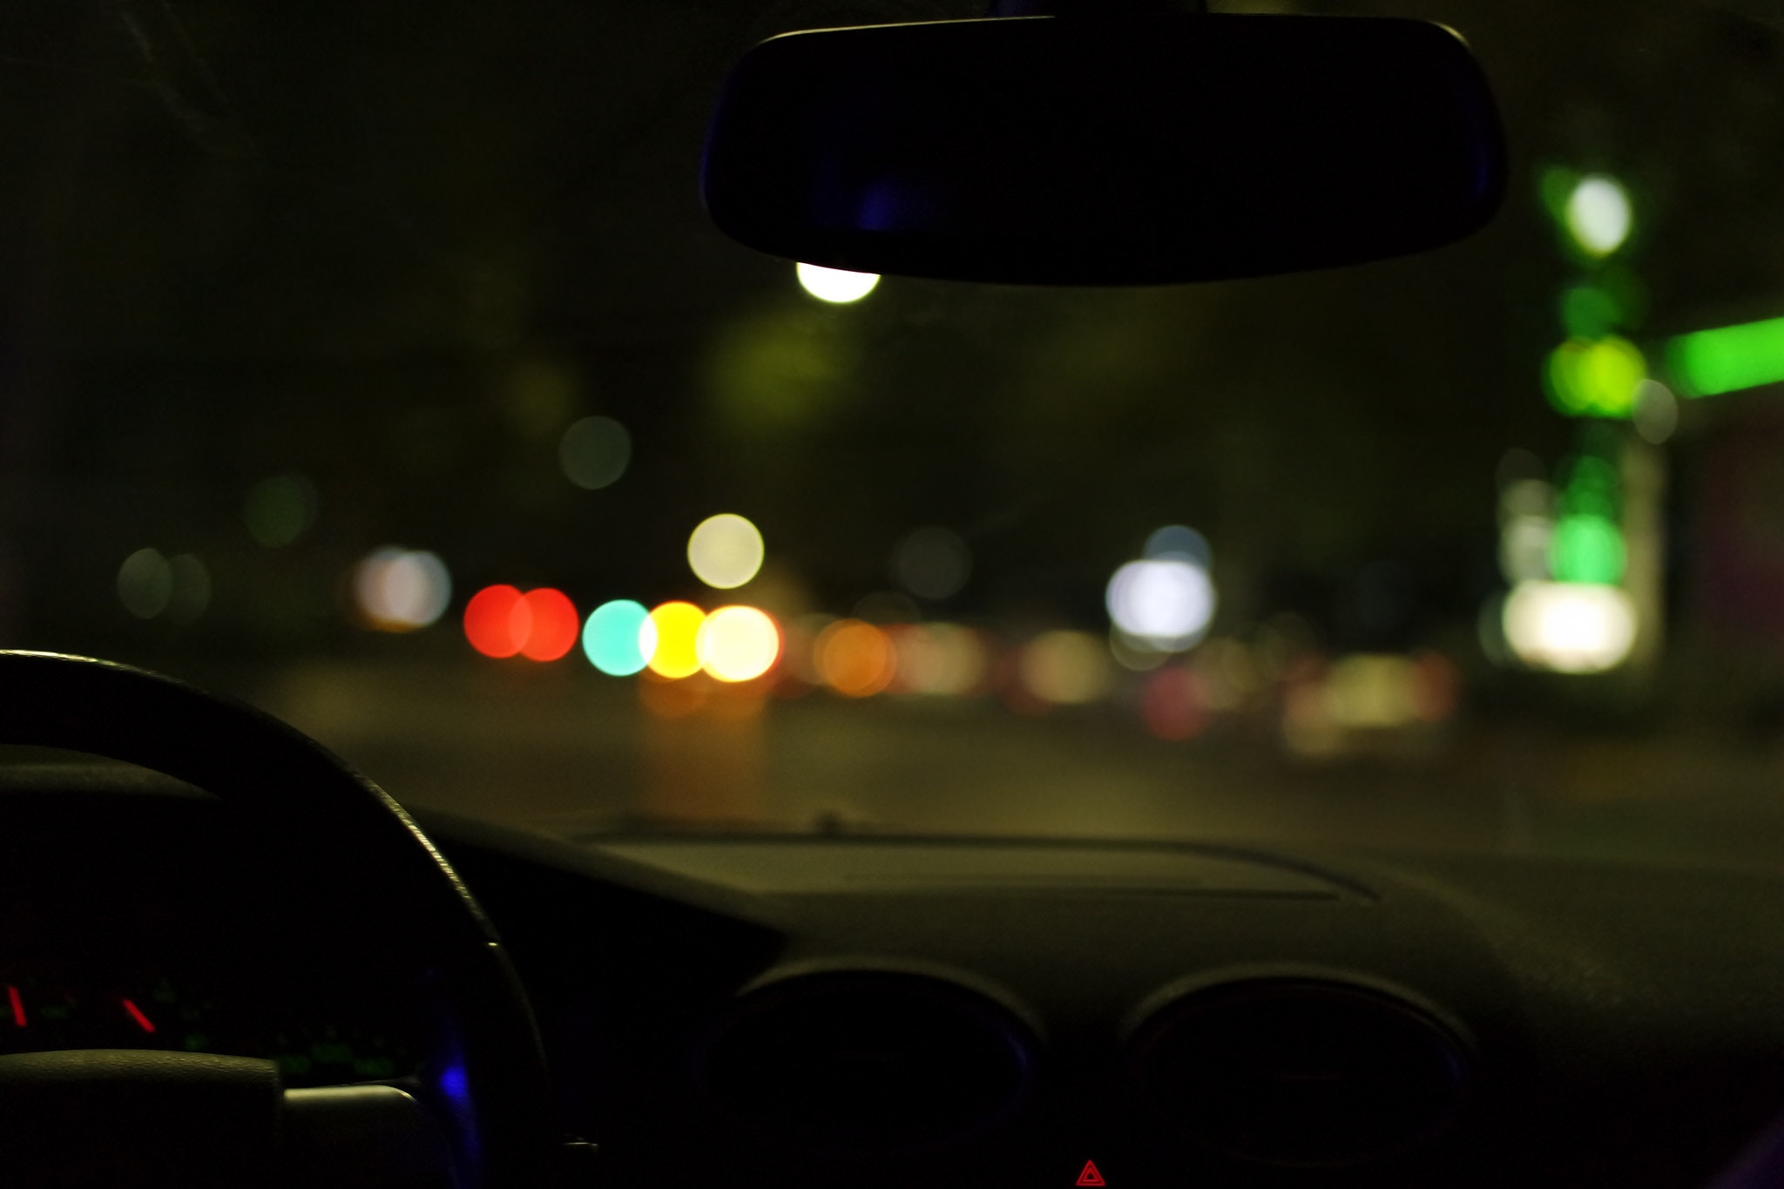
INTRODUCTION
Car parking is a major issue in modern congested cities of today.
There simply are too many vehicles on the road and not enough parking space. This has led to the need for efficient parking management systems.
Thus we demonstrate the use of IOT based parking management system that allows for efficient parking space utilization using IOT technology.
Our IOT project will use the raspberry kit along with an ultrasonic sensor.

Slide 3

INTEGRATION WITH IOT
The manual intervention is overcome after the IOT implementation. The gap is bridged by using sensors.
The system detects if parking slots are occupied using ultrasonic sensors. When a car slot is occupied, the sensor senses and the led glows.
At the time of checkout when a particular car leaves the allotted slot, there wont be any obstruction in the ultrasonic sensor beams and hence this would result to the fact that the car has left.
Hence, the bill will get generated automatically.

Slide 4
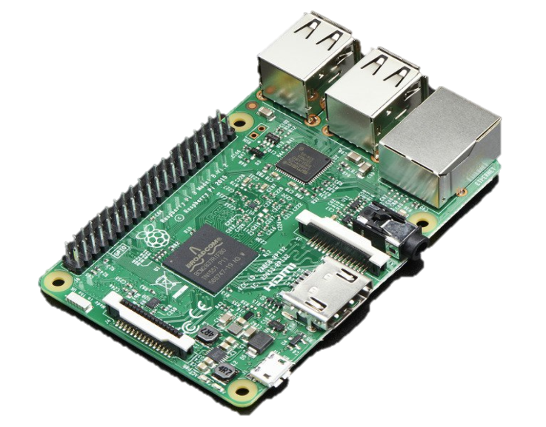
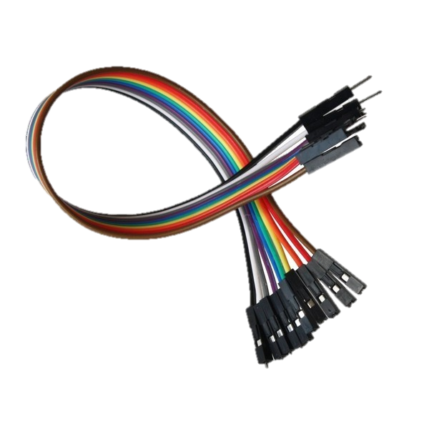
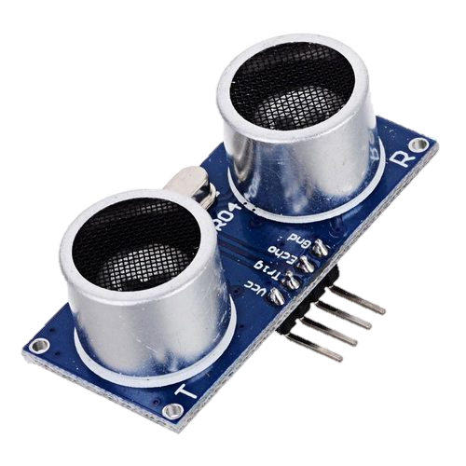
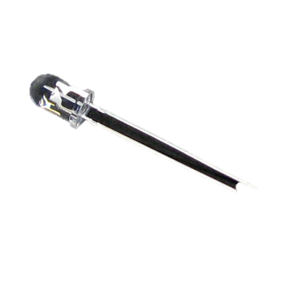
REQUIREMENTS
Raspberry Pi kit
LED
Ultrasonic sensors
Resistors
Jumper Wires
Breadboard

Slide 5
LITERATURE SURVEY
Expert Systems
Mobile agents move within the nodes of a network and are made dynamically during the runtime.
Fuzzy Logic based Systems
Fuzzy theory is used for building the support knowledge and heuristics of the high-level expert human.
Wireless Sensor based systems
A number of low cost sensor nodes make up a Wireless Sensor Network (WSN).
These systems are not architected for car parking management, though they are effective for checking traffic and road condition.
Sent to destination systems for performing different tasks with the up to date code and algorithm.

Slide 6
GPS Based Systems
The information about the location and availability of a parking space near the destination is provided to the drivers by the current GPS-based vehicle navigation system.
Vehicular Communication Systems
This scheme provides the real-time parking navigation service, intelligent antitheft protection, and friendly parking information dissemination to the driver.
Vision based Systems
. Every car has a unique Vehicle Identification Number (VID) associated with it. For overcoming the common discrepancies of the existing vision based target parking position labelled methods in dark indoor parking sites, it proposes a light stripe projection based free parking space recognition method. For recognition of the 3D information of parking site, light stripe projection method is also used.

Slide 7
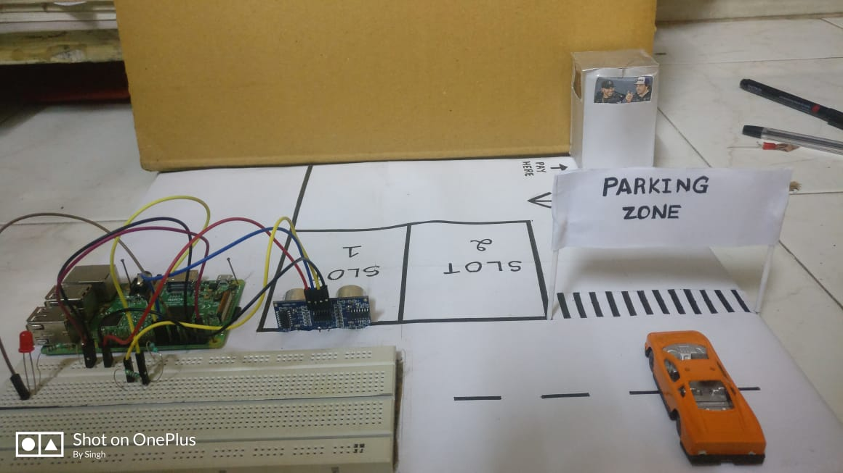
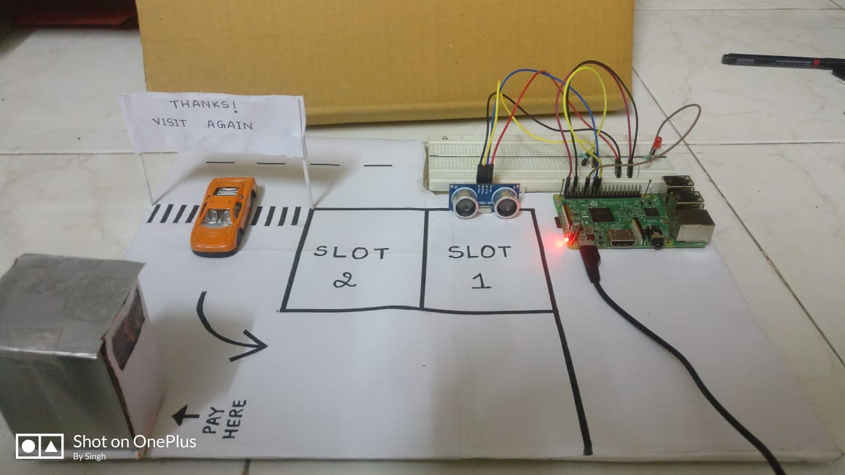
IMPLEMENTATION
A. Initial State:
B. Before car enters the parking slot
Initial state of Parking Zone before car enters
Before car enters the parking slot, LED is off to show availability

Slide 8
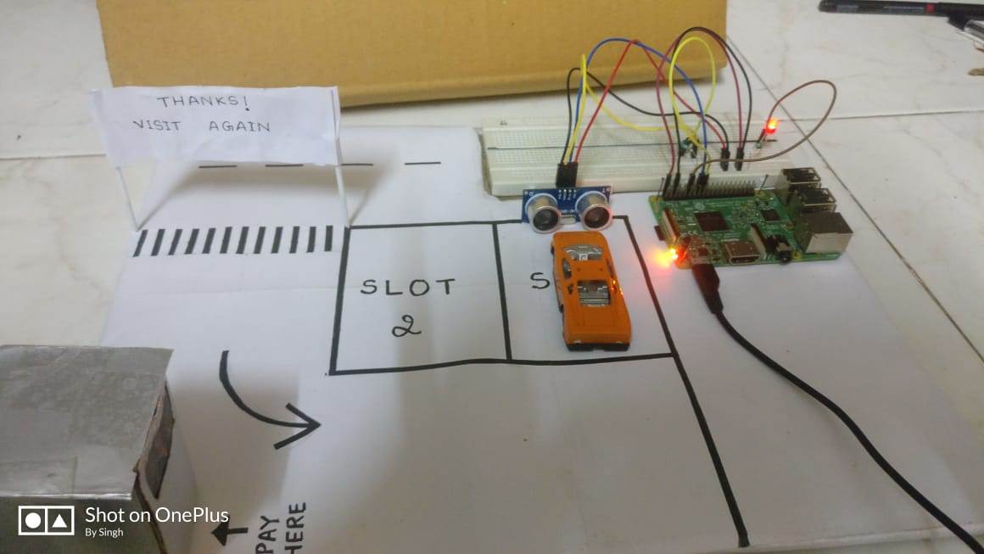
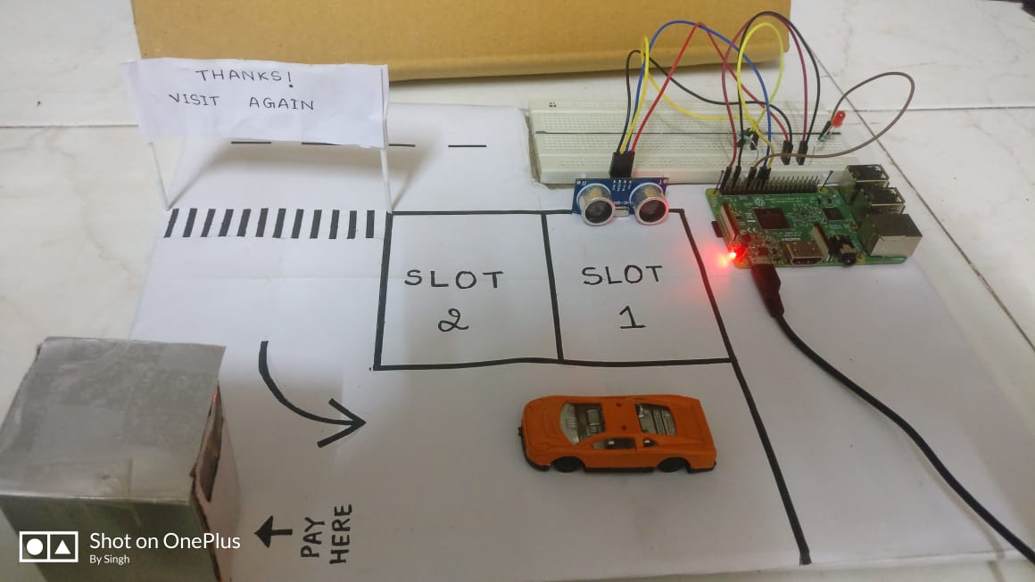
C. When Car occupies parking slot:
D. When Car exits parking slot:
When car enters slot, it gets occupied and LED glows to denote unavailability of that slot
When car exits slot, LED stops glowing and thus spot becomes available again

Slide 9

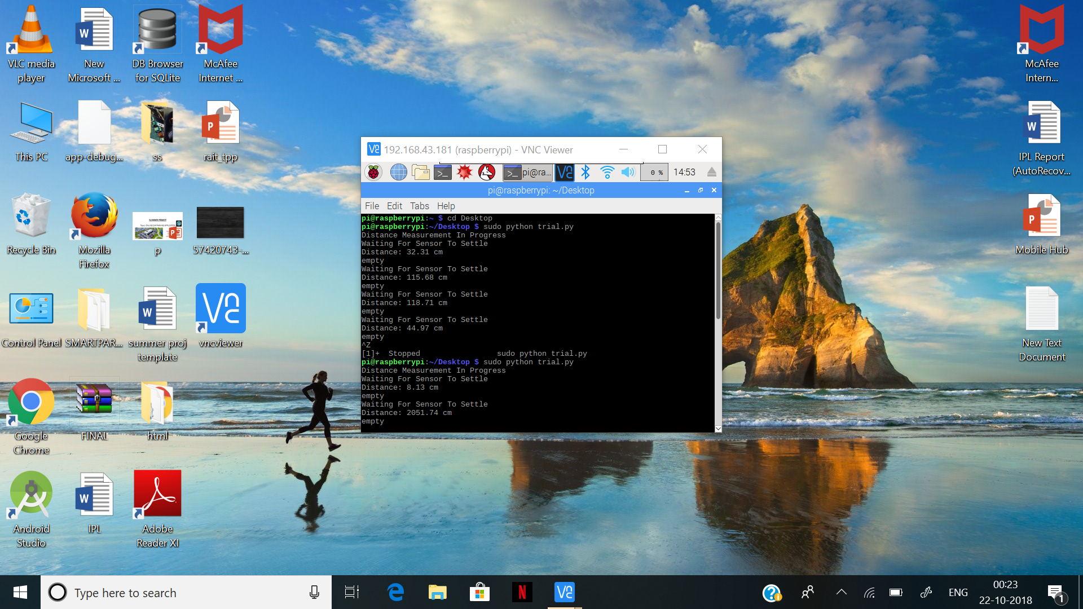


OUTPUT
A. Initial State:
C. When Car occupies parking slot:
B. Before car enters the parking slot
D. When Car exits parking slot:

Slide 10
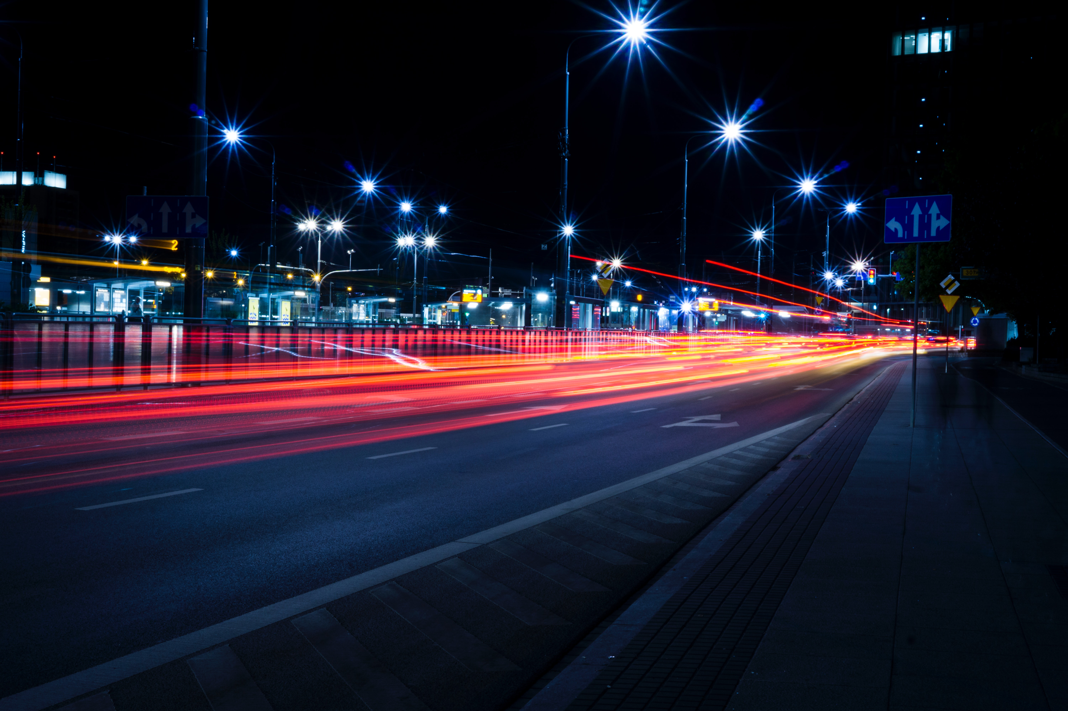
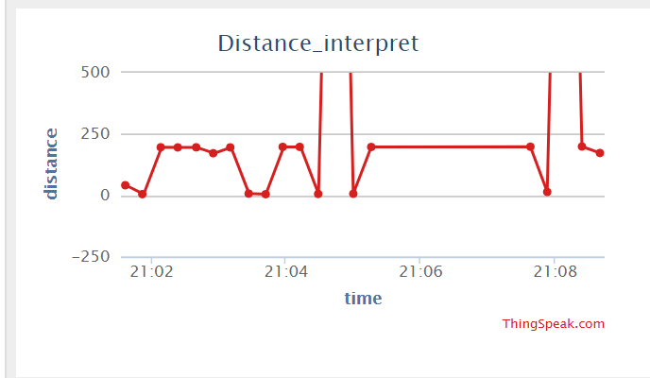
INTERPRETATION

Slide 11
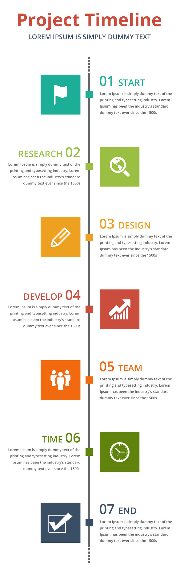
TIMELINE
13-20 AUGUST: The topic was decided and Raspberry Pi was chosen as microcontroller
21-31 AUGUST: Research was done on existing systems and features of project. Requirements were finalised.
1-7 SEPTEMBER: Design and layout of the project was finalized.
8-22 SEPTEMBER: The project was developed employing sensor and coding the Raspberry Pi
23-28 SEPTEMBER: The final project was run for test cases and submitted.
05 END

Slide 12
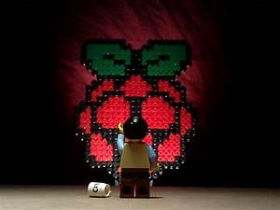
THANK YOU

